Slide 1
Product Sale Analysis​ Using​ Data Analytics ​
Presented By,
NAME : K.NITHISH
REG : 912421104025

Slide 2
Phase 2 : INNOVATION

Slide 3

Introduction​
Objective​
Abstract​
Data analysis​
Market Segmentation​
Diagnostic Analysis​
Data Collection​
Sales management​
Conclusion​

Slide 4

Introduction
Product sales analysis is reviewing your sales data to identify trends and patterns. Sales data can help you make better decisions about your product, pricing, promotions, inventory, customer needs other aspects of your business. Sales analysis can be as simple as reviewing your sales figures regularly ​
Product introduction is the marketing tactic used to increase sales by advertising a product before it’s released. A company’s sales or marketing division is usually in charge of this process that begins when a product has finished testing or been authorized for sales. The marketing team uses techniques to create a consumer response, including excitement about new ideas or solutions.​
For example, a company schedules a new phone to release in three years. In order to increase sales, the company may create advertisements, host demonstrations or create a temporary production team in anticipation of the product’s arrival..​

Slide 5

objective
The sales objectives you set need to make sense for your business or department. You might be setting sales objectives that focus on:​ Increasing annual sales and profit​ Increasing customer numbers​ Increasing upsells and cross-sells​ Improving customer retention​ Increasing conversion rates​ Increasing sales rep productivity​ Cutting the time sales reps spend on non-sales tasks​

Slide 6

abstract
Product analytics is the process of analyzing how users engage with a product or service. It enables product teams to track, visualize, and analyze user engagement and behavior data. Teams use this data to improve and optimize a product or service.​
Data abstraction allows consumers to use a product without knowing how it works internally. It has several benefits for product development, including making a more convenient user experience and safeguarding the product’s uniqueness.​

Slide 7

Data analysis
Data analysis is the process of inspecting, cleansing, transforming, and modeling data with the goal of discovering useful information, informing conclusions, and supporting decision-making.​
Data analysis has multiple facets and approaches, encompassing diverse techniques under a variety of names, and is used in different business, science, and social science domains.​
In today’s business world, data analysis plays a role in making decisions more scientific and helping businesses operate more effectively​

Slide 8
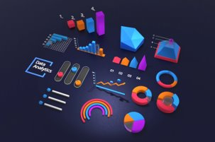
Market segmentation
Market segmentation data analysis is a method of breaking your customers or potential market down into actionable categories- into groups that you can treat differently from one another in an effort to reach them more effectively.​
Market segmentation is a process companies use to break their potential customers into different sections. This allows the company to allocate the appropriate resource to each individual segment which allows for more accurate targeting across a variety of marketing campaigns.​

Slide 9
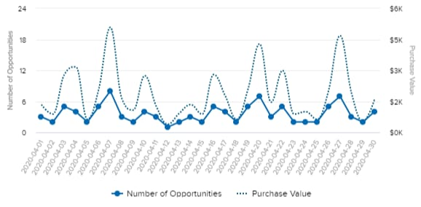
Sales Oppurtunities

Slide 10
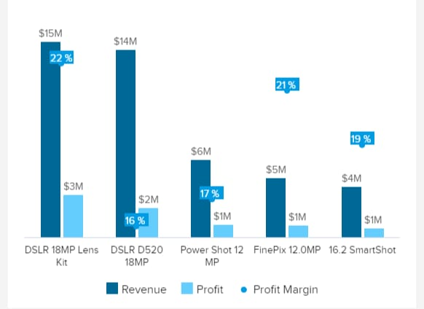
Revenue and profit

Slide 11
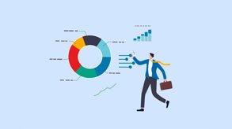
Diagnostic analysis
Diagnostic analytics allows you to analyze why people are not converting or purchasing by looking at which steps they were at when they dropped off, and inferring why.​
It is common for the number of users to decrease at each stage of the marketing funnel.​

Slide 12

Data collection
Data collection or data gathering is the process of gathering and measuring information on targeted variables in an established system, which then enables one to answer relevant questions and evaluate outcomes. ​
Data collection is a research component in all study fields, including physical and social sciences, humanities, and business.​
The goal for all data collection is to capture evidence that allows data analysis to lead to the formulation of credible answers to the questions that have been posed.​

Slide 13
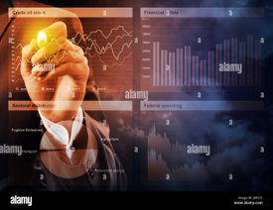
Sales management
Sales management is a business discipline which is focused on the practical application of sales techniques and the management of a firm’s sales operations. ​
It is an important business function as net sales, through the sale of products and services and resulting profit, drive most commercial business. These are also typically the goals and performance indicators of sales management.​ Sales manager is the typical title of someone whose role is sales management. The role typically involves talent development.​

Slide 14

conclusion
Product data analytics is an essential aspect of the product management process. It enables teams to analyze user behavior and product performance and make informed decisions to improve the product and customer experience.​

